Slide 1

Divorce and Women
Notes:
This file created specifically for Sumayyah Ahmed

Slide 2

Why is divorce more difficult for women?

Slide 3
This presentation covers the issues of
mental health, financial problems and childcare responsibilities, along with how divorce could be transformational for women and how they could be more independent, stronger and more valuable than before.

Slide 4
Agenda
1. Mental health
2. Financial impact
3. Childcare responsibilities
4. Transformational for women
5. Stronger and valuable than before

Slide 5

Mental Health

Slide 6
1. Mental Health
Changing habits could be a reason for depression and anxiety.
Losing concentration could lead towards mental health problems.
Being alone is another reason for depression.

Slide 7

Financial Impact

Slide 8
2. Financial Impact
Buying unnecessary medicine or alcohol
Is a big reason for poverty.
Not being able to start work because of feeding or bearing a baby could be a reason for financial difficulties.
Spending too much money on friends and neighbors for getting rid of loneliness is a key of poverty.

Slide 9

Childcare Responsibilities

Slide 10
3. Childcare Responsibilities
Many hours for working at home
and taking care
of child/children.
Women get more parenting time than father.
Taking care of children alone is
hard for a woman
than with their dad.

Slide 11

The Upsides of Divorce

Slide 12
4. Stronger and more independent
Women can start learning about themselves as how to deal at a difficult time.
Women can have a partner at any age.
Women can do anything they want; they are powerful and strong.

Slide 13
5. More valuable in personal life and career
Women can continue their education after divorce.
Women’s lives don’t end after divorce.
Women can make everyone proud of her.

Slide 14
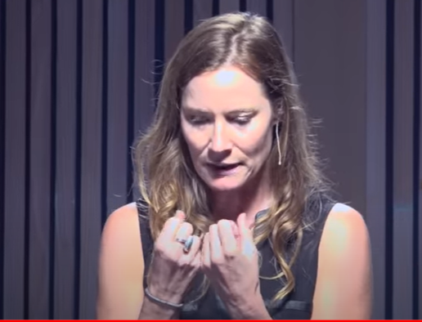
Divorce is hard. Many flashbacks, repeating the same mistakes, too many acceptations, and not trying to fix their own mistakes take people towards divorce.
After divorce, people should take time to understand themselves before getting into a new relationship. In this way, they could get a chance to find out their own mistakes instead of blaming their spouse.
Click on this link for more information!
https://www.youtube.com/watch?v=MSbPBXp5Qcw

Slide 15

In conclusion, women can do anything they want. They will face some problems for sure, but they should keep trying and working hard. One day everyone will be proud of them.

Slide 16
References
“Divorced Dads Drive Carpool, Too: How Families Can Share Household and Parenting Responsibilities After Divorce.” Elise Buie Family Law, 27 May 2021, elisebuiefamilylaw.com/how-families-can-share-household-and-parentingresponsibilities-after-divorce/.
Elochukwu, Amaka. “Stigma and Mental Health Impact of Divorce on Women: A Nigerian Perspective.” Rights of Equality, 10 Oct. 2022, www.rightsofequality.com/stigma-and-mental-health-impact-of-divorce-on-women-in-nigeria/#:~:text=For%20some%2C%20the%20com.
Endeweld, Miri, et al. “Do the Privileged Always Win? Economic Consequences of Divorce by Income and Gender Groups.” Social Indicators Research, vol. 159, no. 1, Jan. 2022, pp. 77–100. Springer Link, doi.org/10.1007/s11205-021-02733-4.
Leopold, Thomas. “Gender Differences in the Consequences of Divorce: A Study of Multiple Outcomes.” Demography (Springer Nature), vol. 55, no. 3, June 2018, pp. 769–97. Duke University Press, doi.org/10.1007/s13524-018-0667-6.
MacGregor, Nancy. “Effects of Divorce on Mental Health.” Harmony Bay Wellness, 28 Aug. 2022, www.harmonybaywellness.com/effects-of-divorce-on-mental-health/.
Smith, Kurt. “How Divorce Affects Men and Women.” PsychCentral, 25 Jan. 2022, psychcentral.com/blog/the-differences-in-divorce-for-men-and-women.

